Slide 1
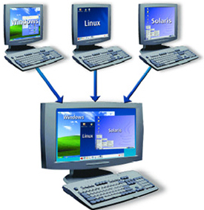
Containers
Docente: Dott. Daniele Gobbo Modulo 1

Slide 2
Module Introduction
This course off is about Docker and Kubernetes, two amazing technologies, which make managing and deploying and also developing more complex applications way easier.
We're going to learn what exactly Docker is.
It's related to something called containers.
We are going to learn:
how to work with Docker and containers with different commands to run
what you can do with Docker
how to solve different problems with Docker
how to use it locally on your machine, on simple projects and more complex projects,
how to deploy projects and applications with Docker
What exactly is docker and why might we want use it?
What's its advantage?

Slide 3
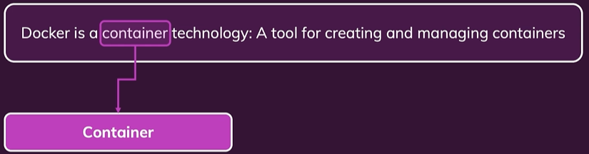
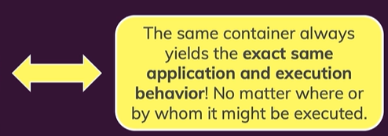
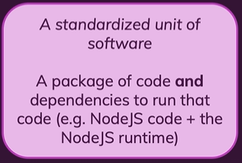
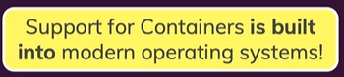

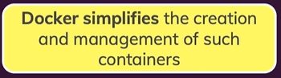
WHAT IS DOCKER?

Slide 4

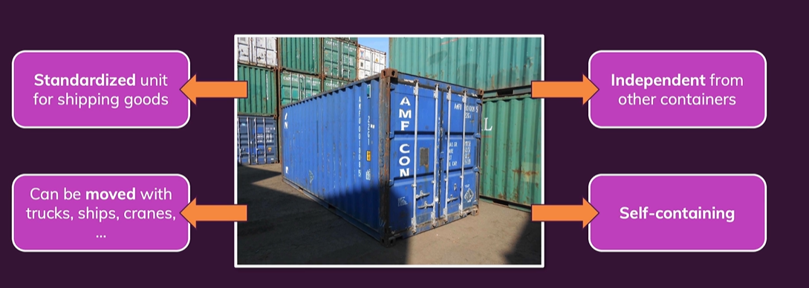
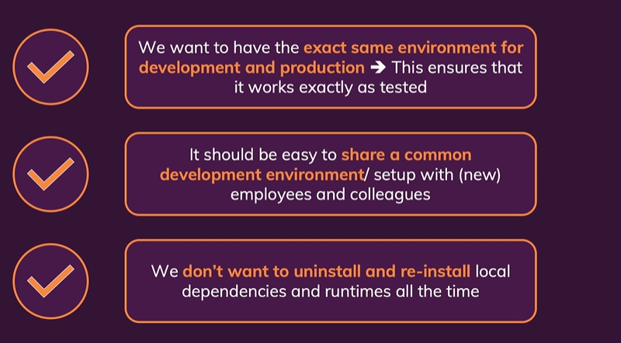
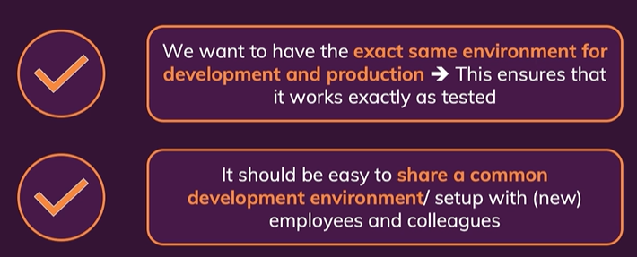
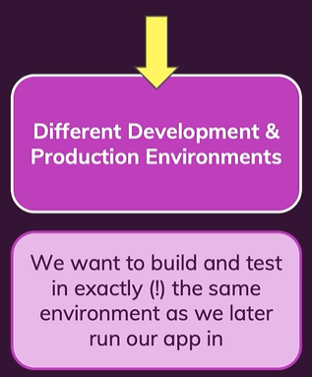
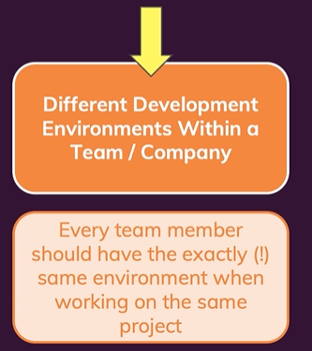
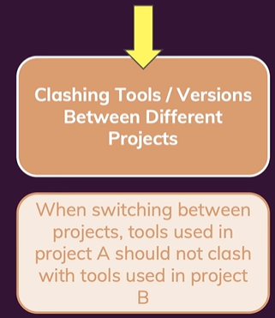
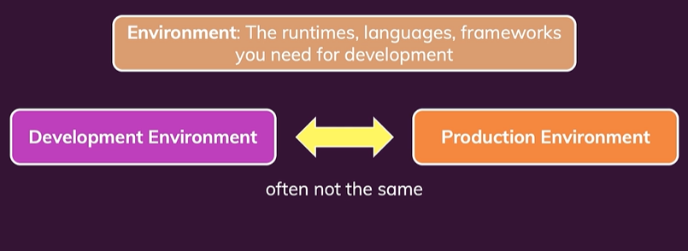


WHY CONTAINERS?

Slide 5
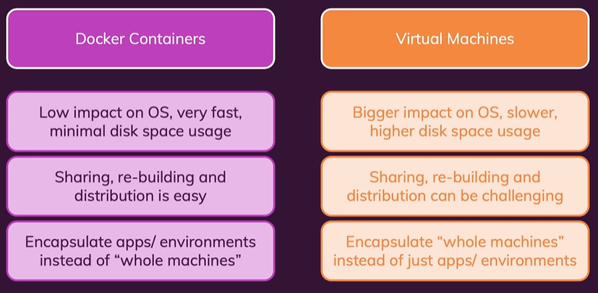
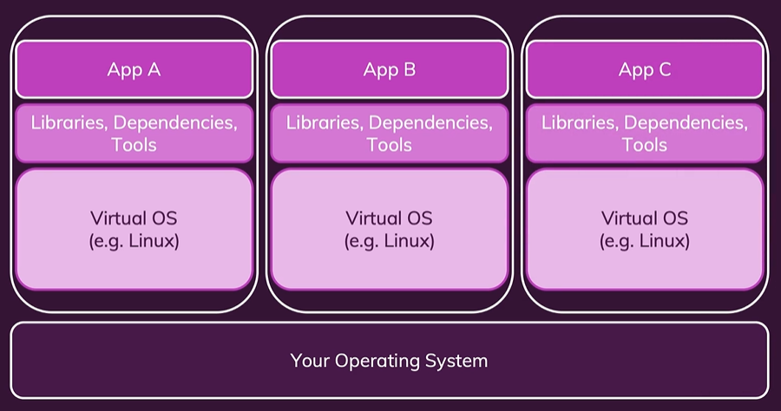
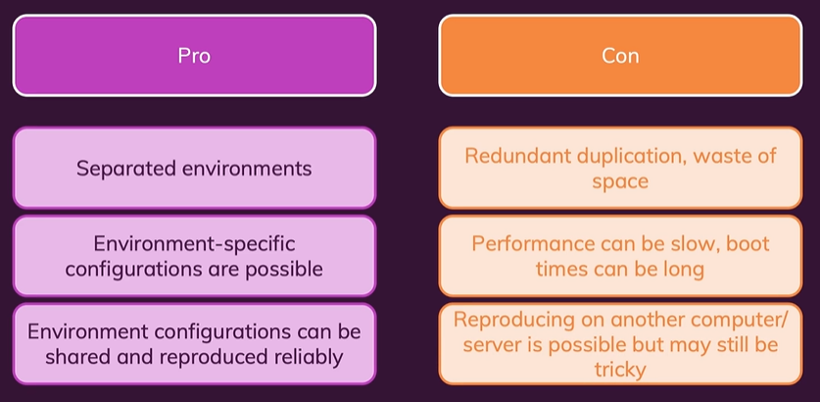
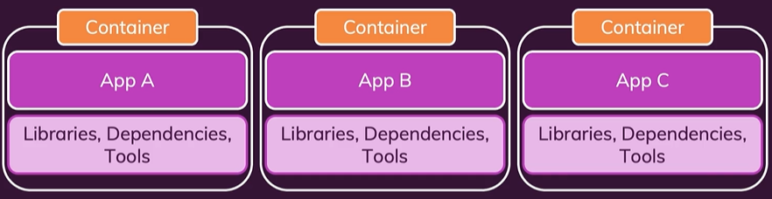


Virtual Machines vs Docker Containers

Slide 6
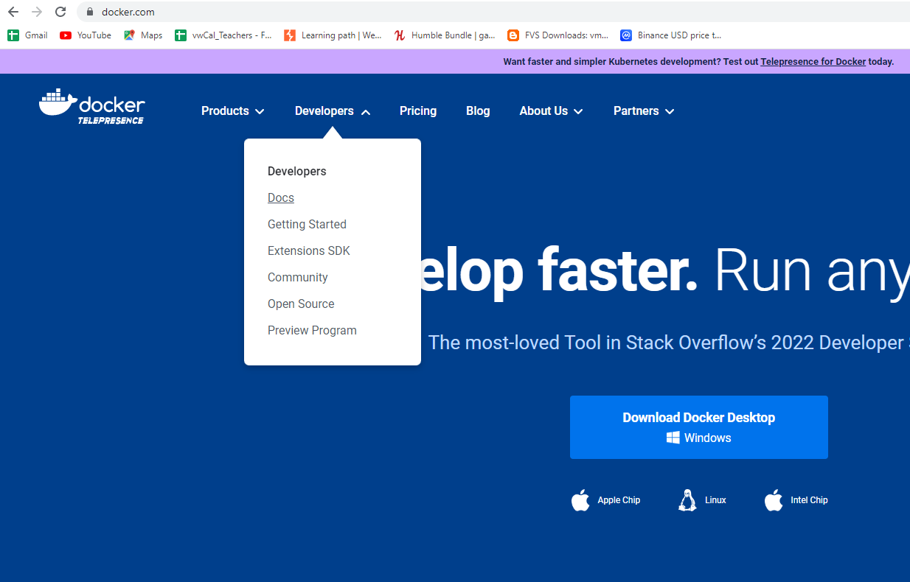
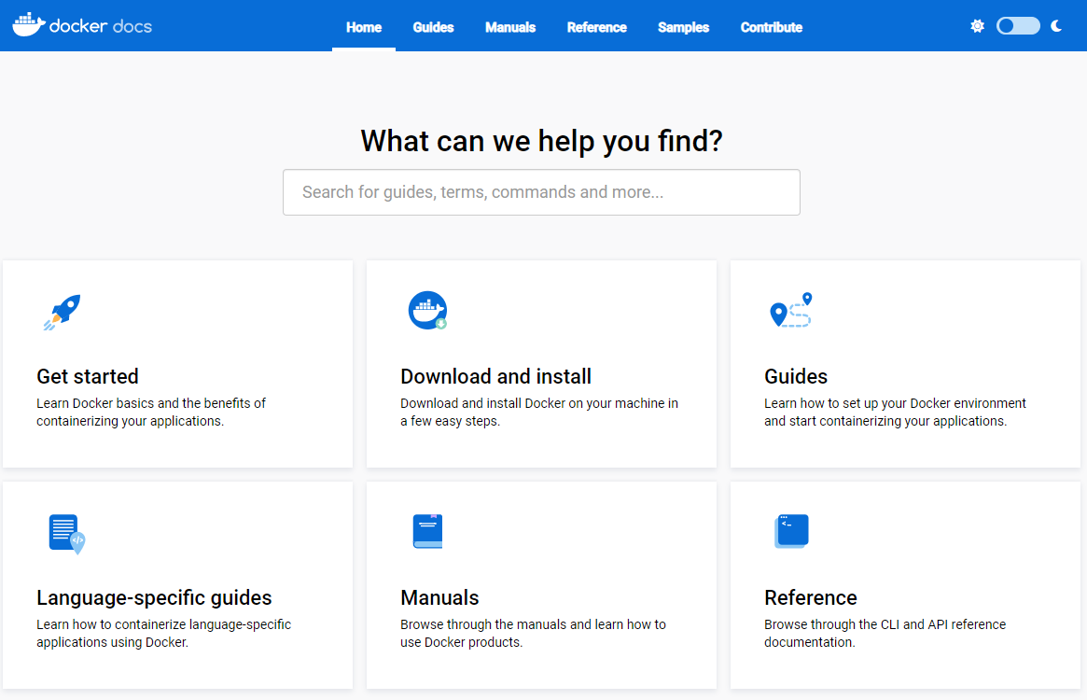
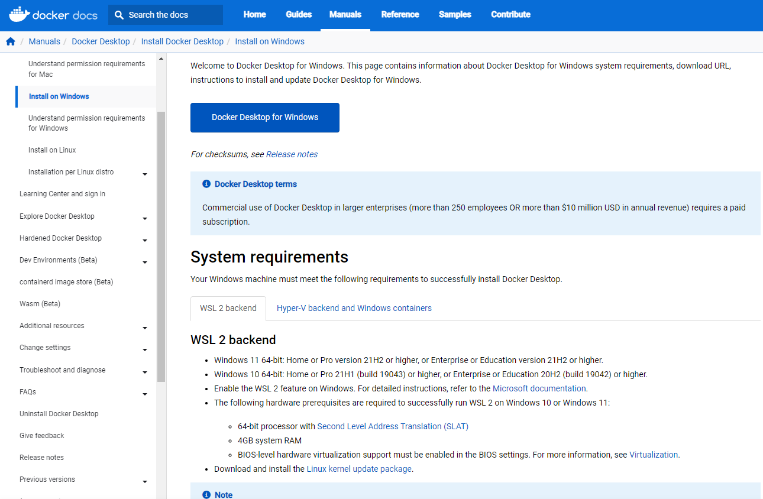
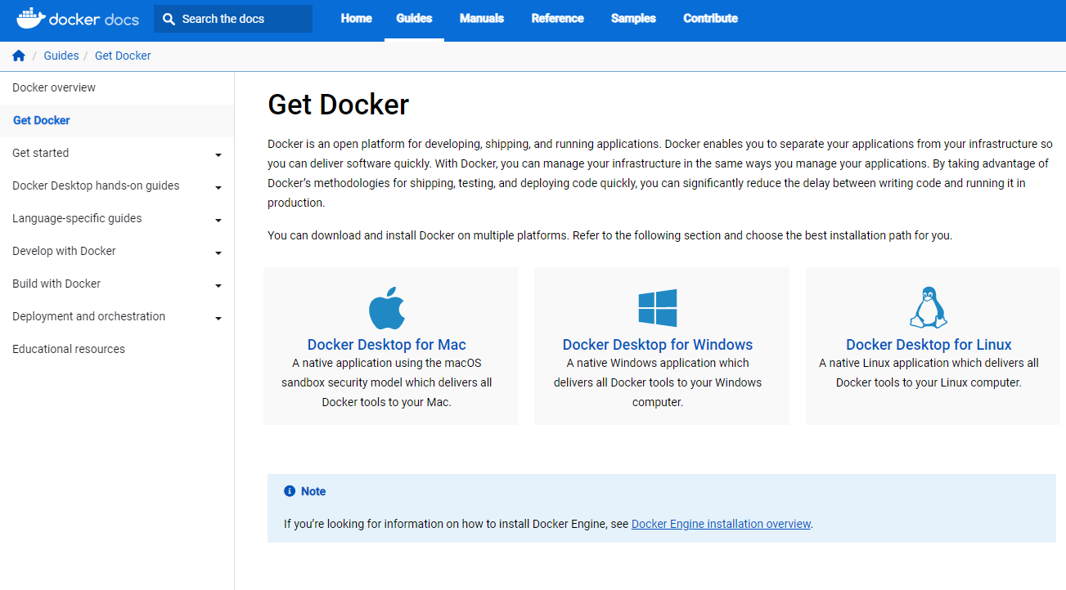
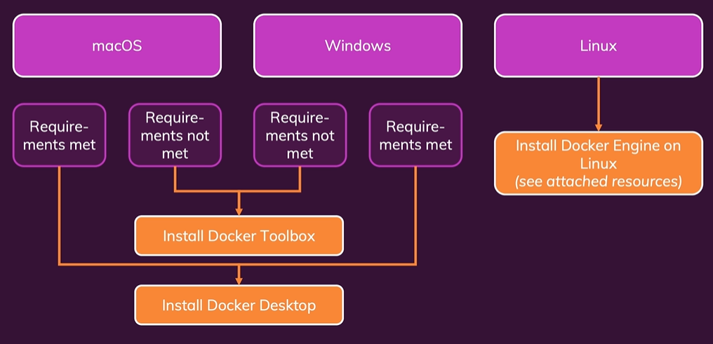
Docker Setup

Slide 7
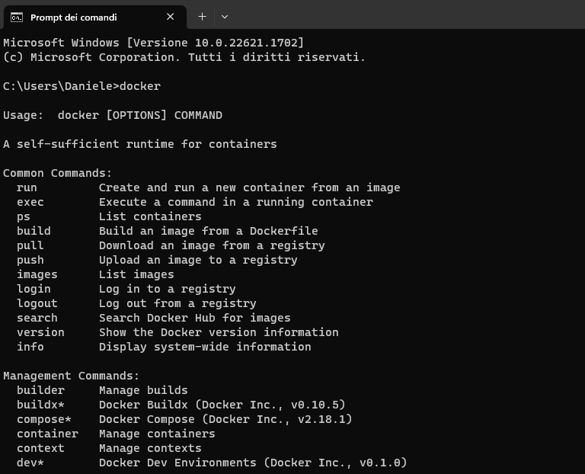
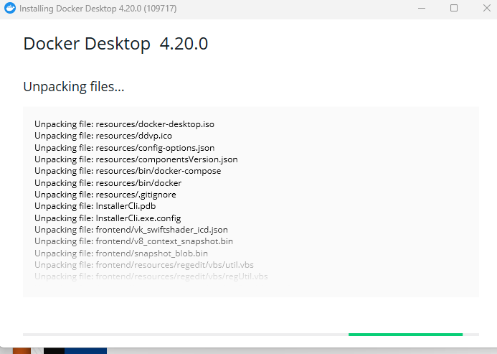
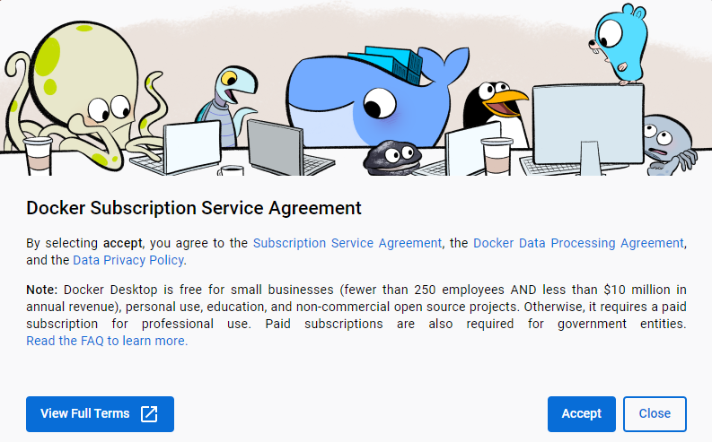
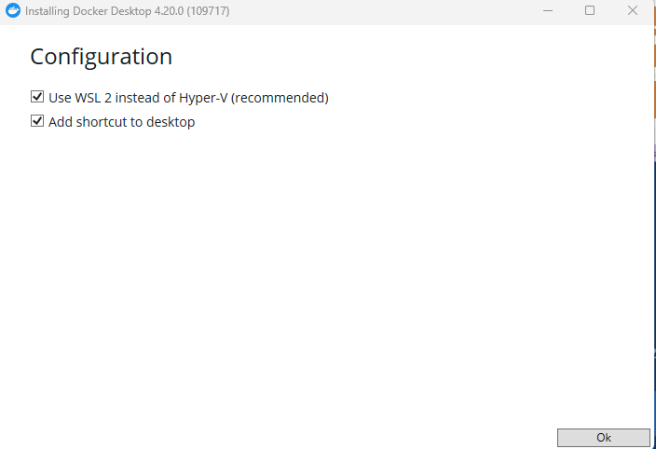
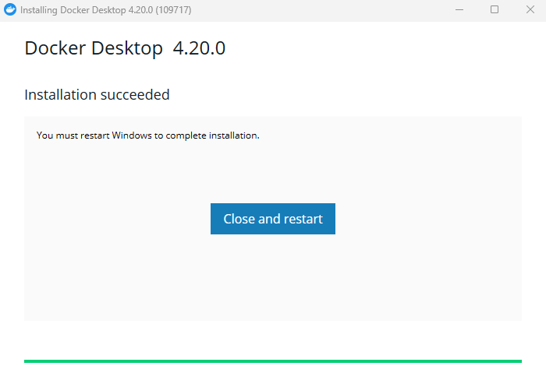
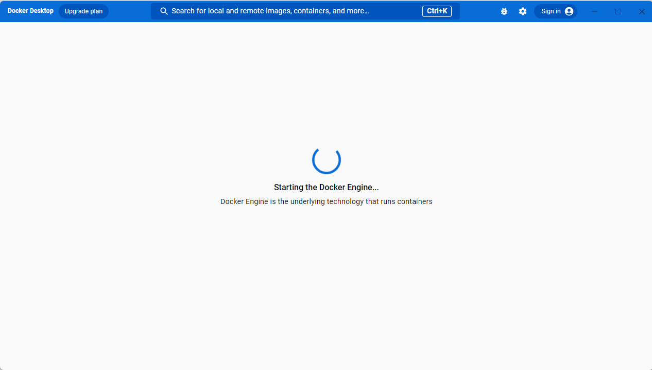
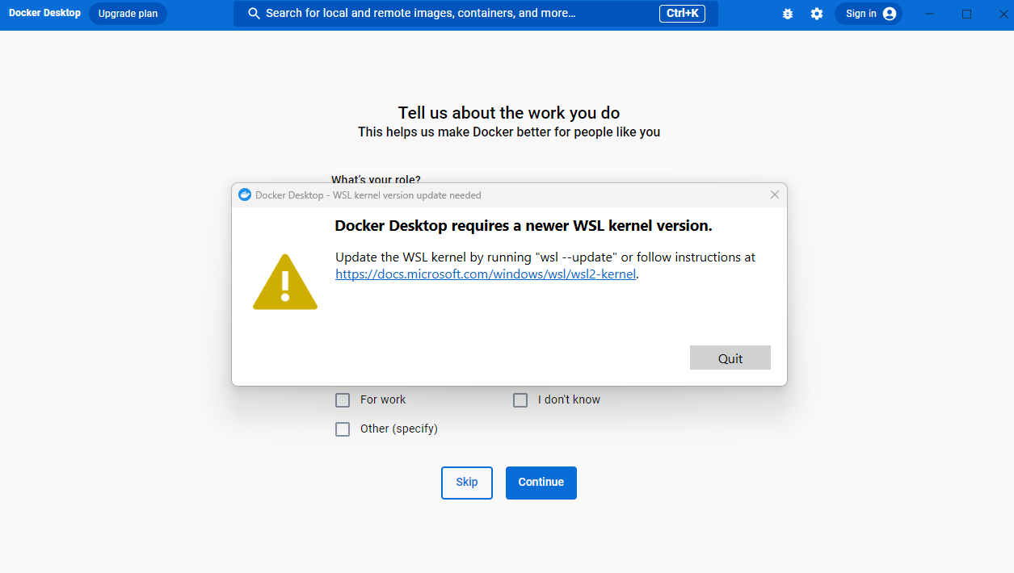
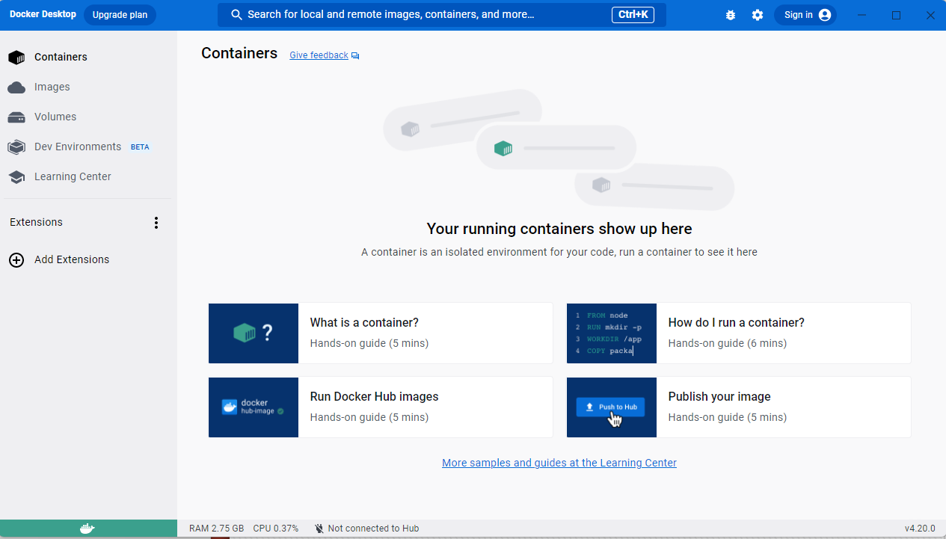
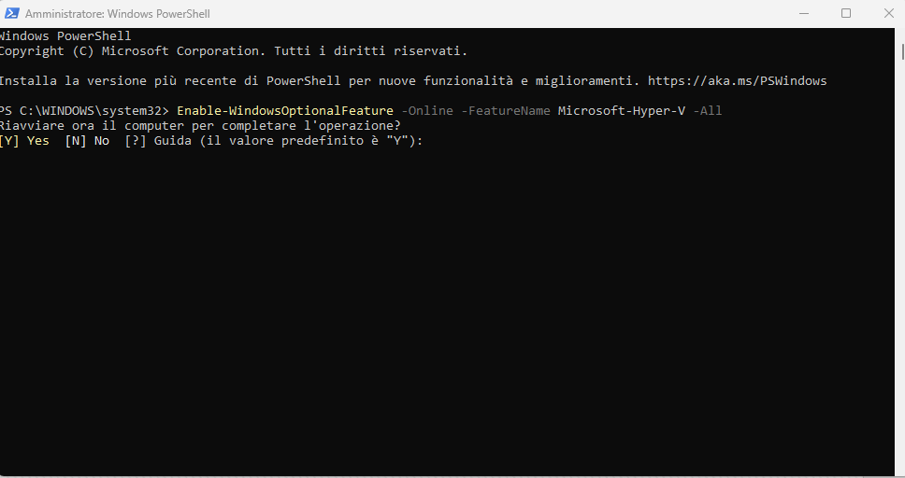
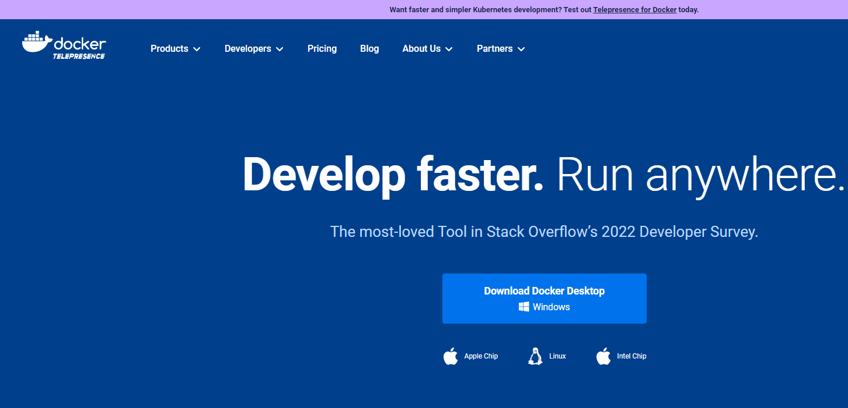
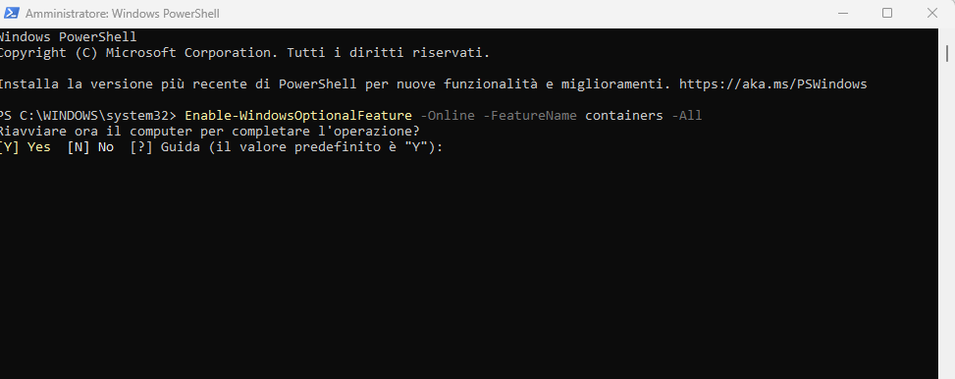
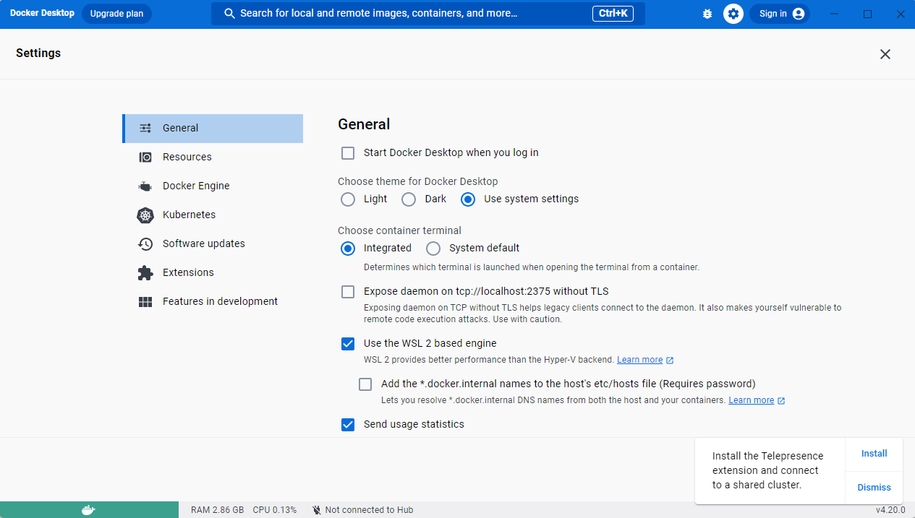
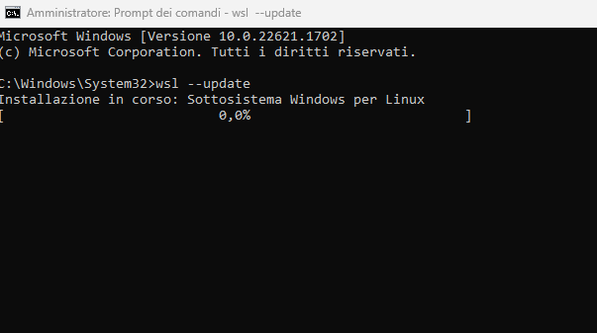
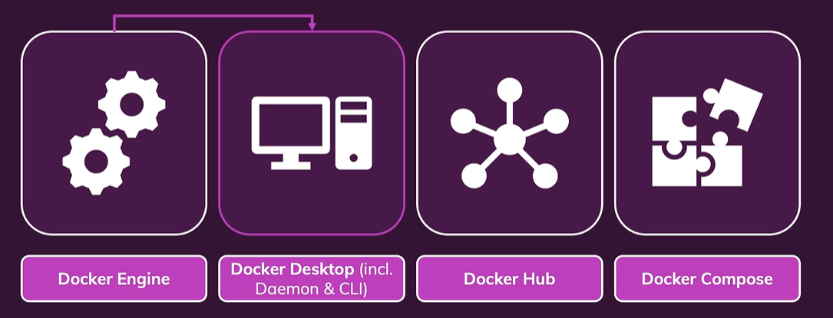
DOCKER SETUP - WINDOWS
Aprire powershell con diritti di amministratore
And with that we got Docker installed
and we're ready to use it.
Dopo il riavvio sempre in powershell digitare il seguente comando….

Slide 8
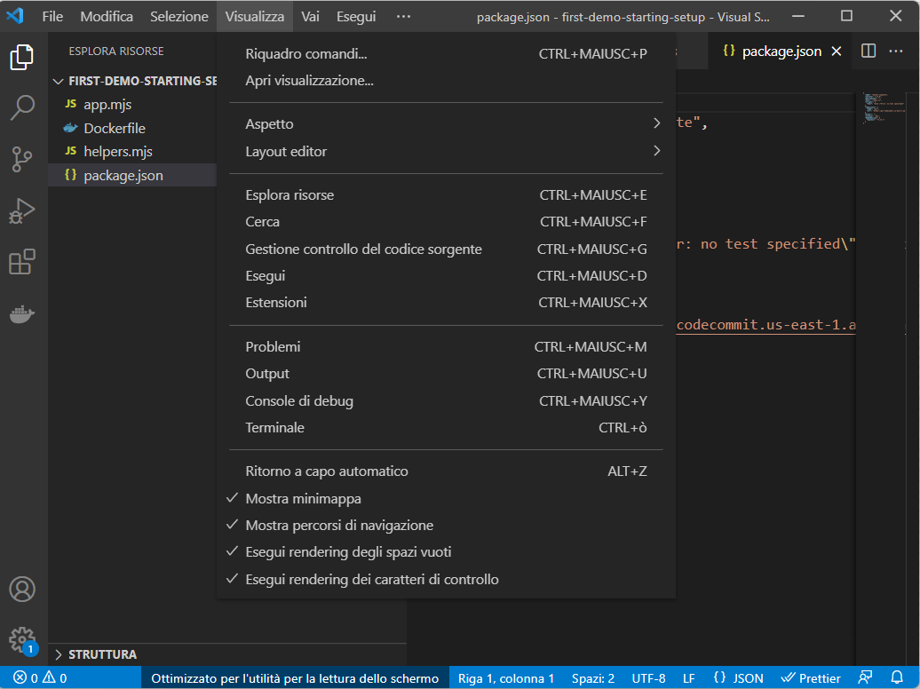
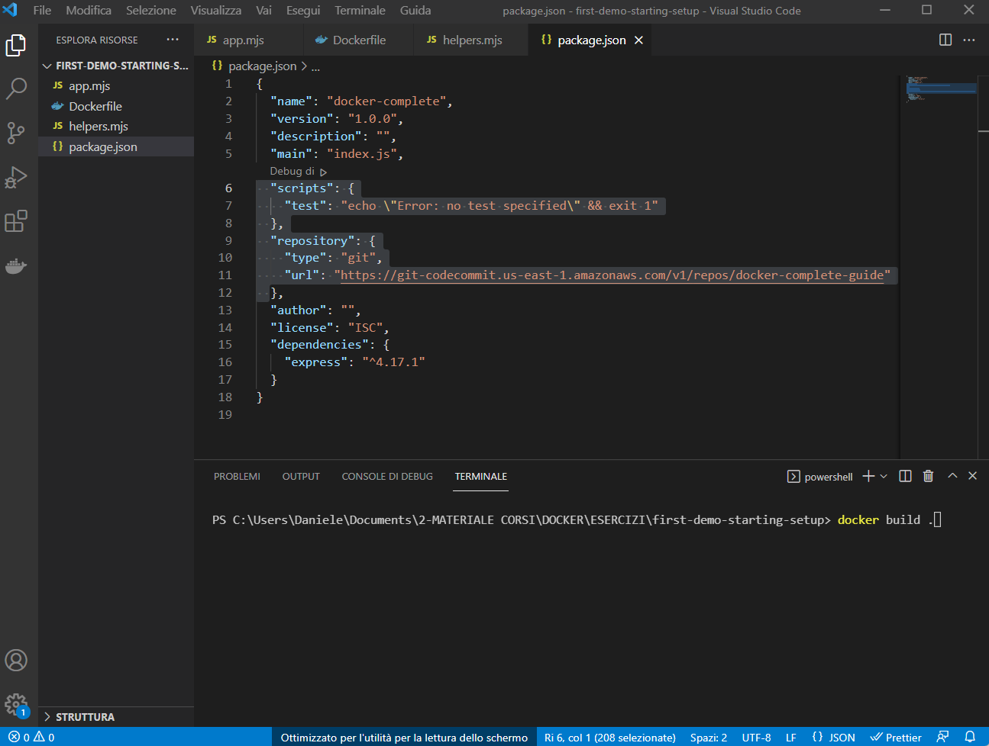
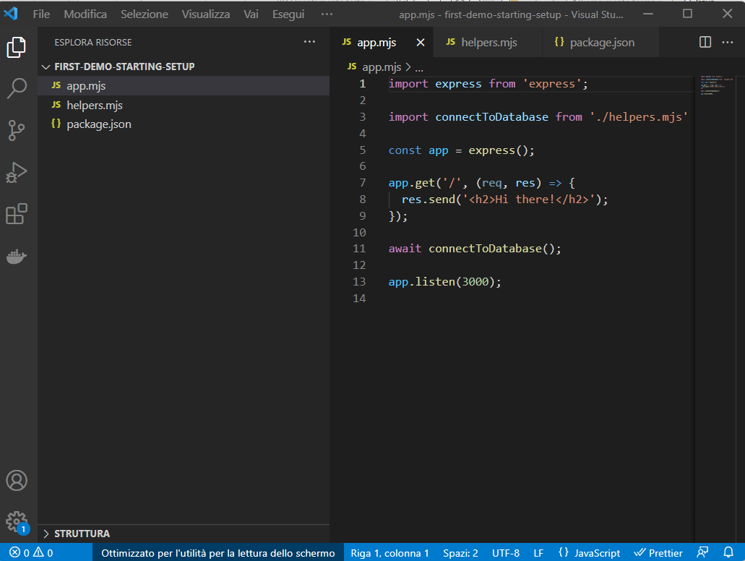
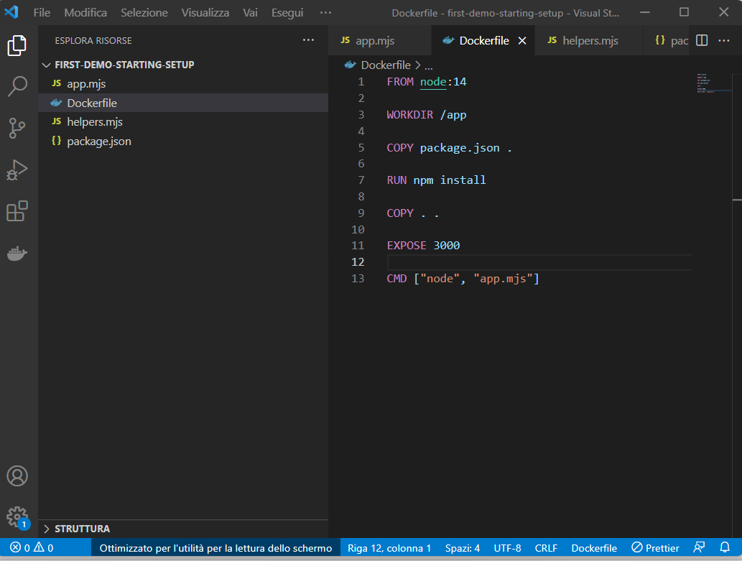
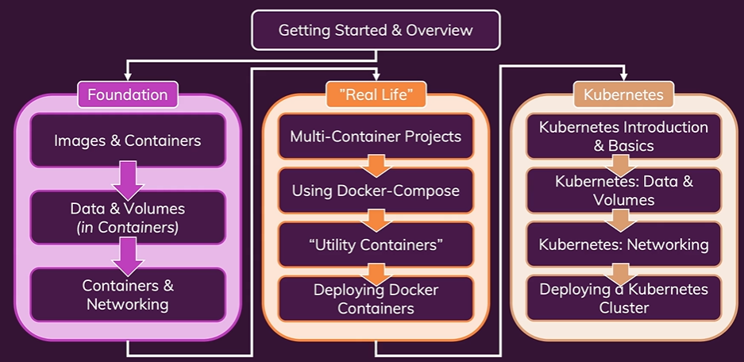
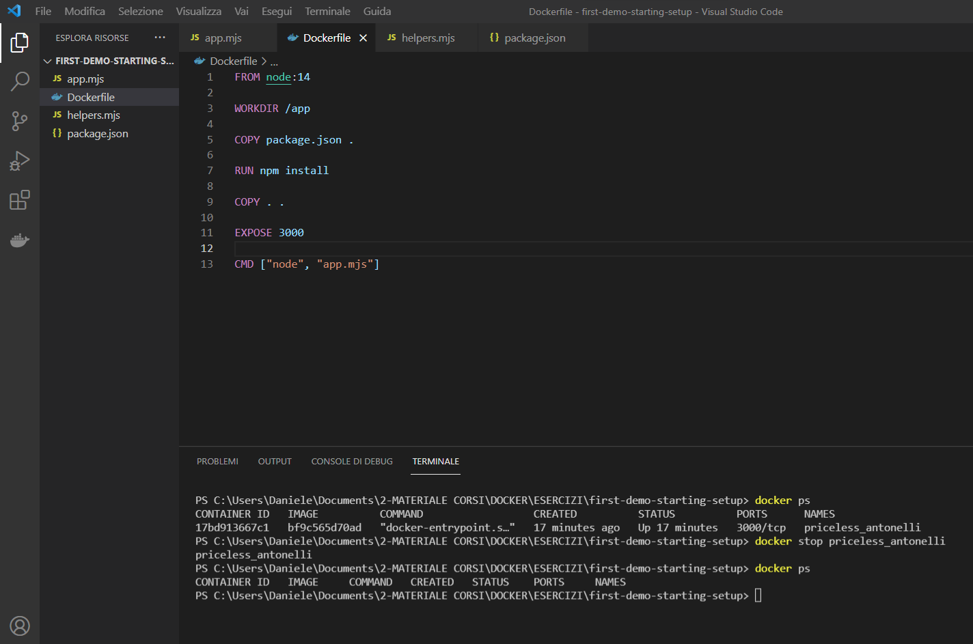
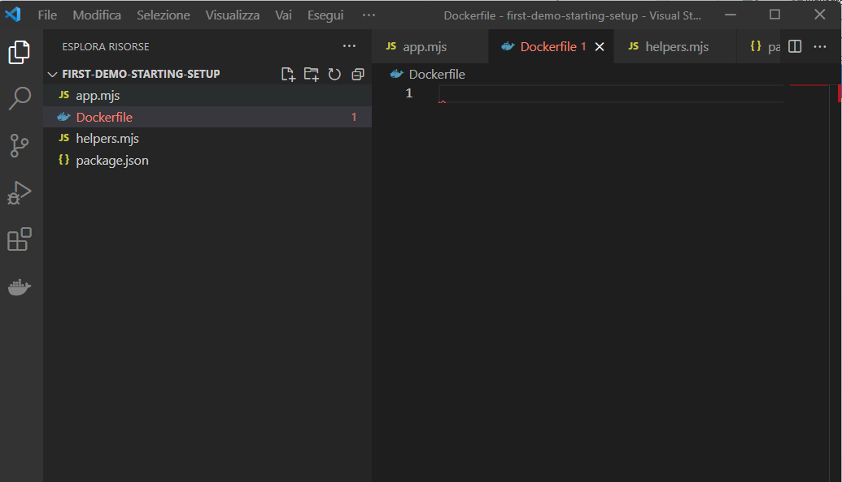
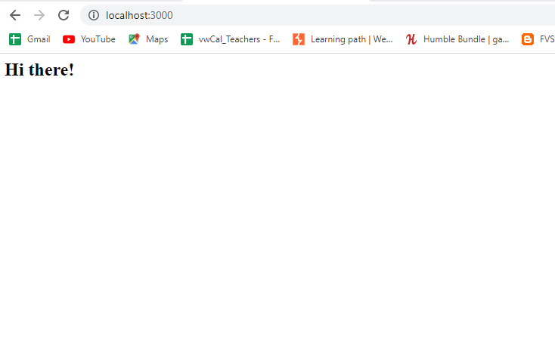
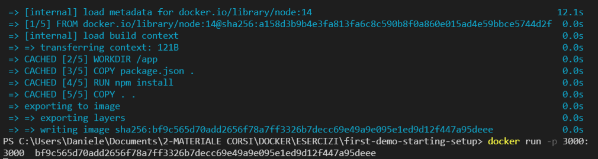
INSTALLING & CONFIGURING AN IDE
So let's create our first container,
We're not going to understand everything here.
We're just going to write some code,
and bring up a container, and we're going to understand all the details later.
I just wanna immediately get something up and running,
We also have this example to validate
that everything is working as it should.
Please Open folder “first-demo-starting-setup” with VisualStudio Code….. Please install docker extension and Prettier code formatter.
We want to run this code in a container.
And for that, we first of all, need to create an image, because containers are always based on images. BE PATIENT……
For the moment to create such an image, we simply create a Docker file, so a file which is simply named Docker file without any extension.
To stop the containers, please open another terminal….
we want to use Node.js as a base image
we now describe to Docker, how our container in the end should be set up.
And we do this by adding a couple of instructions.
we have a certain directory in the container file system.
we then copy the package.json file,
into our working directory
Now with the Docker file created, we open up a terminal
we run the npm install command
to install all the dependencies our application needs
we copy the rest of the code here
we expose port 3000 to the outside world
we execute app.mjs with the node command

